Slide 1
Lecture 12:
Requirements & Specifications (3)

Slide 2
Outcomes
Requirement determination
Requirement analysis
Software system structure
Software Requirement Specification (SRS)

Slide 3
Models
We must create models of the domain and application being analyzed. The most important are the Structural and Behavioral models
The structural model describes
  data structures – Standard template library
  object structures and associations between them
The behavioral model describes
  the events the system responds to
  the states through which the system is driven

Slide 4
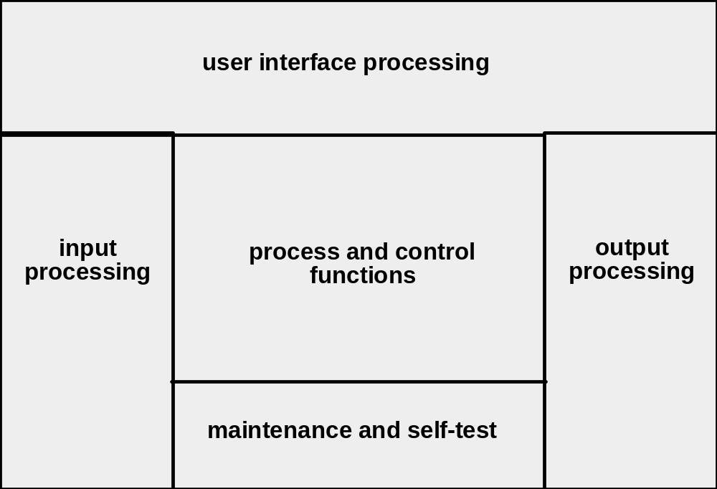
System Modeling
System model template

Slide 5
System Structure
Interactions between subsystems
Boundary
Sub-system
Sub-system
Input
TRANSFORMATION
Output
Sub-system
Environment
Sub-system
Means of Regulation and Control
System: resources, continuity, measures of performance
System Context Diagram (SCD): establishes the information boundary between the system to be implemented and the environment in which the system is to operate.
Notes:
The boundary of a system is set by the specification.
The specification allows the system implementation to be hidden.
The preconditions identify the assumptions made by the system about the environment.
The postconditions identify the guarantees of the system.

Slide 6
SCD Example
Sorting station operator
Request
Queries
Bar code reader
Sorting mechanism
Bar code
Shunt commands
Conveyor Line Sorting System
Formatted reporting data
Line speed indicator
Conveyor line
Mainframe
Diagnostic data
Sorting station operator

Slide 7
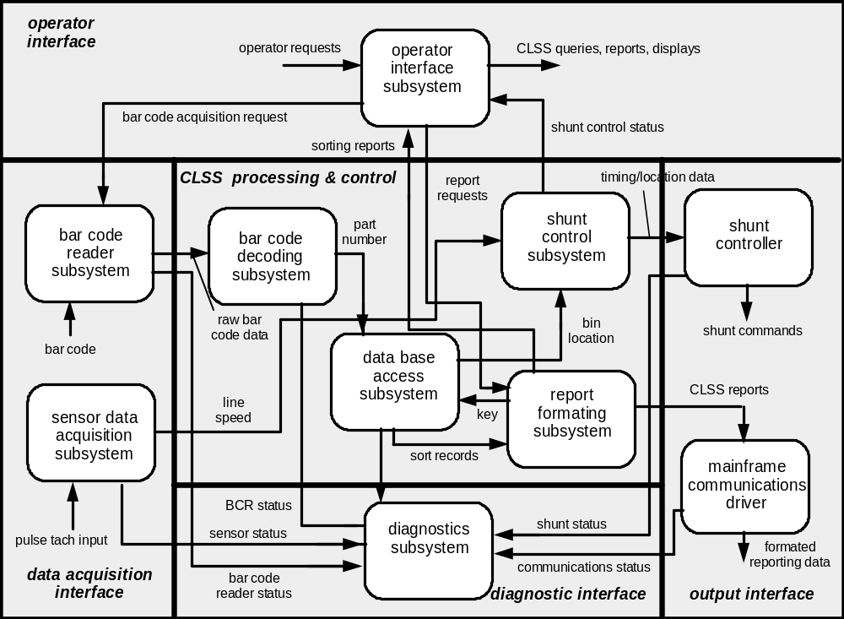
Architecture Flow Diagram

Slide 8
General System (Hardware/software) Architecture
User
Interface
Physical
Device
Input
Driver
Output
Driver
Physical
Device
Application
Physical
Device
Input
Driver
Output
Driver
Physical
Device
Maintenance
Interface

Slide 9
Windowing System
Button
Screen
Mouse
Application
Driver
Cursor
Edit Box
Button
Edit Box
Driver
Driver
Screen
Event Manager
Mouse
Keyboard
Driver
Driver

Slide 10
What is a specification?
Purpose
  Representation before existence
  Simplification
  Capture essential exterior characteristics of a module
    Interaction with environment:
      Services
      Requests
  Internal matters are not considered
How specification works
  Aligned with problem solving strategy
    Identify, define → specification
  Captures purpose
    Gives the module designer a sense of direction

Slide 11
What is a specification? (cont.)
Examples
  Abstract example of system as black box and interface
    defining services: inputs, outputs and behavior
    defining requirements: expected support from environment
  Particular example:
    strtok – Find the next token in a string
    char *strtok(char *strToken, const char *strDelimit)
    Return Value
      A pointer to the next token found in strToken. NULL is returned when no more tokens are found. Each call modifies strToken
Elements
  Descriptions of all services
  Descriptions of all required support

Slide 12
Specification VS Description
Description
  May be ambiguous
  May be incomplete
  May be dependent on unstated assumption.
Specification
  To be unambiguous
  To be complete
  With assumption exposed

Slide 13
Preconditions and Postconditions
The preconditions identify the assumptions made by the system about the environment.
The postconditions identify the guarantees of the system.

Slide 14
Minimal Structure of a Specification
Identifier | [ID]
Capability | [function, procedure or property of software]
Description | [as indicated]
Inputs | [as indicated]
Source | [as indicated]
Outputs | [as indicated]
Requires | [as indicated]
Preconditions | [conditions which must be established before capability is exercised]
Postconditions | [conditions guaranteed to be true after the capability is exercised]
Side effects | [as indicated]

Slide 15
A Specification Example
Identifier | UR_1
Capability | Enter a team’s score
Description | The user shall be able to enter a score for a team in a game
Inputs | Round, game, team
Source | By menu from the user
Outputs | The score is entered into the database
Requires | Access to the fixture data structure
Preconditions | A game and team have been selected
Postconditions | The score is entered for the team in the game
Side effects | None

Slide 16
Exercise 1: Convert the square root function into a specification
square_root(x: DOUBLE): DOUBLE is
require -- preconditions
non_negative_argument: x >= 0
ensure -- postconditions
correct: (Result * Result – x).abs <= epsilon
 | Benefits | Obligations
Client | obtains y such that x × x ≈ y | supplies x ≥ 0
Supplier | need not handle x < 0 (what to do?) | delivers y such that x × x ≈ y

Slide 17
Exercise 2: Convert the stack put procedure into a specification
put(x: G) is
require
room_available: not full
ensure
correct: stack.top = x
added: not stack.is_empty
 | Benefits | Obligations
Client | stack.top = x | not stack.is_full
Supplier | Avoids full test (what to do?) | stack.top = x not stack.is_empty

Slide 18
Things to achieve in specifications
Observe the following:
  Specify function (what) not implementation (how)
  As simple as possible, but no simpler
  Testable
  As unambiguous as possible
  Develop a model of the application and its environment to capture data and interaction. That is, model what crosses the system boundary.
  Make sure that interactions with other applications are also considered. (They are also part of the environment).
  Create a model from the user’s point of view (a cognitive model), not a design or implementation model.
  Make sure specifications can be modified. They are always incomplete because they are models.
  Make sure specifications can be traced to users’ requirements and vice versa.

Slide 19
What is a Contract?
Description and Purpose
  An agreement between two parties defining
    Obligations
    Benefits
Example
  House mortgage
 | Benefit | Obligation
Owner | Live in house | Repay the loan with interest
Lender | Interest on loan | Provide funds for purchase
How it works
  Mutual benefits balance mutual obligations

Slide 20
Mixing Specification and Contract
Purpose
  Capture essential exterior characteristics of a module
    Interaction with environment
      Services
      Requests
  An agreement between two parties defining
    Obligations
    Benefits
  Terminology
    Precondition - an assumption the designer of a service provided, upon which a module can rely. The list of benefits.
    Postcondition - a guarantee fulfilled by the service. The list of obligations.

Slide 21
Benefits of the Specification as a Contract
Allocation of responsibility:
  If a precondition is violated, the user is wrong
  If a postcondition is violated, the supplier is wrong
As a consequence:
  Errors are localized
  Responsibility can be pushed back to the user
  Defensive programming is avoided
  Design information can be captured, ready for use

Slide 22
SRS Template and Example
MIL-STD-498 template for Software Requirements Specification (SRS)
  is available on DSO
SRS Example
  Can be found in section 2.6 and 2.7 of “Practical Software Development – Study Guide”, which is available on DSO
Some hints on writing specification
  Is available on DSO

Slide 23
Summary
Requirements and issues
Determining requirements
  Seven functions:
    inception, elicitation, elaboration, negotiation, specification, validation, and management
  Methods
  Specification
System Engineering
  System model template

Slide 24
Readings
Pressman 6th edition:
  Chapter 7
  Section 8.1
Pressman 5th edition:
  Chapter 11
  Section 10.5, 10.6

